Slide 1
Experimental and theoritical study on the binary systems of cyclohexanol + alkylamine (C4 and C6) at (303.15 to 318.15)K
گروه آموزشی شیمی فیزیک، دانشکده شیمی، دانشگاه بوعلی‌سینا، همدان
Mehdi dadkhah Tehraniaª, Hossein iloukhani^{a*} , Khatereh Khanlarzadeh^{b}
ªDepartment of chemistry, University of Bu-Ali Sina, Hamadan, Iran
E-mail: m.dadkhahtehrani@che .basu.ac.ir
^{a*}Department of chemistry, University of Bu-Ali Sina, Hamadan, Iran,
E-mail: iloukhani@basu.ac.ir
^{b}Rac Analitical Chemistry Laboratory, Hamedan, Iran E-mail: kh.khanlarzadeh@che.basu.ac.ir

Slide 2
Abstract
Density and speed of sound for binary systems of butylamine (BUT) and hexylamine (HEX) in cyclohexanol (CYC) were measured at temperature ranges of (303.15 – 318.15) K. From the measured experimental data, excess molar volume, $V_{m}^{E}$ and deviation in isentropic compressibility, ${∆k}_{S}$ , were calculated. The results were analyzed to discuss the effect of the alkyl chain length, the orientation and number of the OH groups and the structural deformation of the molecules in the face of unlike molecules. The values of $V_{m}^{E}$ and ${∆k}_{S}$ were correlated by Redlich ̶ Kister polynomial equation. The obtained values were used to evaluate the nature and type of intermolecular interaction in multicomponent mixtures. Theoretical calculations were also performed using the molecular dynamic simulation to validate the data in which the associated molecular interactions were compared and discussed. The agreement between theoretical and experimental data was acceptable for all studied systems.
Keywords: Excess molar volume, deviation in isentropic compressibility, cyclohexanol, butylamine, hexylamine

Slide 3
Introduction
Understanding the experimental physicochemical properties and phase behavior helps to improve the experimental thermodynamic knowledge of solutions and theoretical models to analyze microscopic and macroscopic simulations and to understand the nature and patterns of molecular accumulation in mixtures. Knowledge of the thermodynamic properties of binary solutions is an important tool in the design and analysis of chemical processes in chemical engineering and petrochemical [1,2]. Excess properties such as $V_{m}^{E}$ , $H_{m}^{E}$ ,$G_{m}^{E}$ ,$C_{p,m}^{E}$ and ${∆k}_{S }$ are a vital branch in thermodynamics of solutions that can help to understand the intermolecular interactions and thermal motions of molecules. Intermolecular interactions in these systems are include solvent-solvent, soluble-soluble, and soluble-soluble interactions. Three contributions can be considered for the formation of these interactions: physical (dispersion, dipole – dipole and induction forces), chemical (self-association and cross-association) and geometric effects [3,4]. Hydrogen bonding plays a prominent and undeniable role in the formation of self-association and mutual-association interactions. In this research work, by using the density and speed of sound at the moment of mixing two binary mixtures of CYC + (BUT or HEX) and ambient pressure were measured [5 – 8] , and from two experimental and theoretical perspectives, the amount of${ V}_{m}^{E}$ and ${∆k}_{S }$was discussed.

Slide 4
Apparatus and procedure
Cyclohexanol (w > 99), butylamine (w > 99) and hexylamine (w > 99) where w is mass fraction, were purchased from Merck and used without any purification. The purity of reagents was checked by comparing the measured densities and speed of sound at (303.15 – 318.15) K with those reported in the literature. The results were in good agreement with the corresponding literature values.
All solutions were prepared by mass on a Mettler AB204-N analytical balance precisely within $±1×{10}^{−3}$ kg which is the uncertainty in the molar fraction values obtained is $±2×{10}^{−4}$.
A high-precision device with a denser vibrating tube and speedometer with an automatic viscosity modifier (Anton Paar DSA 5000, Austria) were used to measure the density and speed of sound of the pure material at (303.15 – 318.15) K. The uncertainties for the density and speed of sound are ${5×10}^{−3}$kg.m⁻³ and ${5×10}^{−1}$m.s⁻¹, respectively. The temperature inside the device was controlled to ${1×10}^{−2}$K with a Peltier device (solid state thermostat). Before measurement, the device was calibrated degassed and double distilled water and dry air at atmospheric pressure.

Slide 5
Conclusion
The negative deviation of $V_{m}^{E}$ and ${∆k}_{S }$observed for binary systems of CYC + BUT and CYC + HEX in Fig. 1a and 1b represents a completely different behavior.
a
b
Fig. 1: Plot of (a) excess molar volumes, $V_{m}^{E}$ and deviation in isentropic compressibility, ${∆k}_{S}$ , vs mole fraction, x₁, for binary systems of (●) {CYC (x) + DEA (1 - x)}, (■) {CYC (x) + TEA (1 – x)}, (▲) {CYC (x) + BUT (1 – x)} and (♦) {CYC (x) + HEX (1 - x)} at 303.15 K. The solid curves represent the corresponding correlation by the Redlich ̶ Kister equation and symbols represent experimental data.

Slide 6
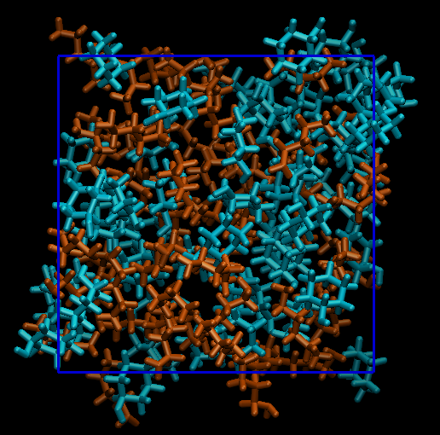
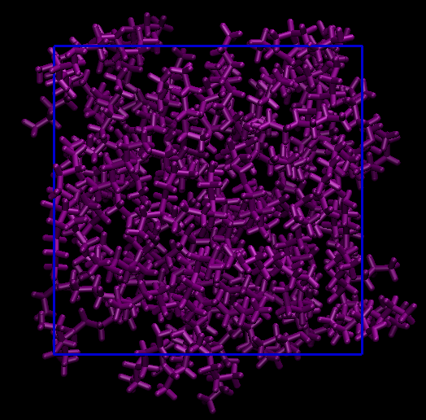
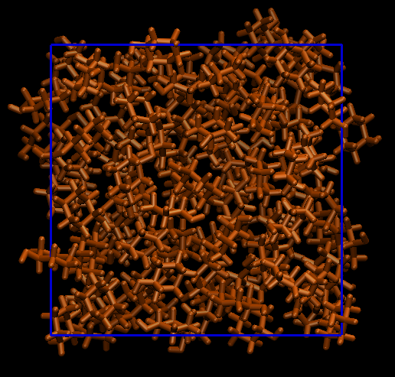
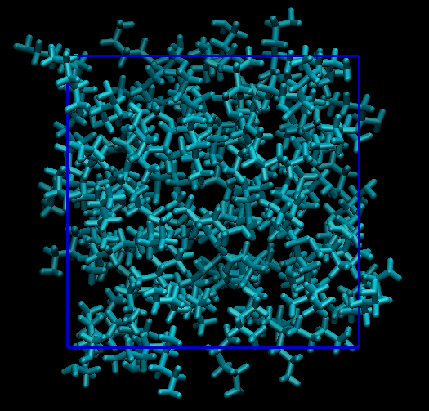
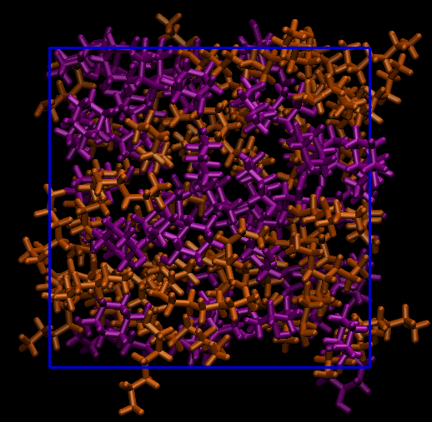
Conclusion
Molecular dynamics simulations were performed using Amber 18 software and the final structure, effective intermolecular interactions such as bond energy were predicted.
CYC + BUT
HEX
∆G = -0. 6918 kcal/mol
∆G = -0.0081 kcal/mol
∆G = -0.1158
kcal/mol
∆G = -183.9594
kcal/mol
CYC
∆G = -0.0081 kcal/mol
CYC
∆G = -2.9825
∆G = -158.9895
kcal/mol
BUT
CYC + HEX
Fig. 2: The final structures and binding Energy in three condition {(100A + 0B), (50A + 50B) and (0A + 100B)} which A and B are cyclohexanol and (butylamine, hexylamine) respectively.

Slide 7
Discussion and conclusion
In the mixing of these alkyl amines with cyclohexane, the formation of intramolecular hydrogen bonds is expected. The electronegativity of N in BUT and HEX is less than the electronegativity O in cyclohexanol, which N more prone to give off the pair of electron and form hydrogen bonding. As shown in Fig. 1a at special temperature, the negative value trend of $V_{m}^{E}$ for these alkyl amines with CYC is: BUT > HEX. By increasing the length of the alkyl chain and the electron acceptor, the pair of nitrogen electrons becomes more stationary and it becomes more difficult to form a charge transfer complex. Also, with increasing length of the chain increases, the interstitial accommodation in the empty pores of cyclohexanol becomes more difficult and it occupies more volume.
Alkyl amines such as BUT and HEX with a linear structure and including an electronegative group, are less likely to intermolecular interaction and, in order to achieve proper stability in the mixed state, prefer intramolecular interactions and negative deviation of ${∆k}_{S }$have been predicted. As shown in Fig. 1b, at 303.15 K, the negative value trend for these alkyl amines with CYC is: BUT > HEX. Temperature is one of the most important thermodynamic properties that has different effects on the chemistry of solutions. In the systems studied, factors such as the thermal motions of molecules, the change in structure from flat to non-flat and vice versa, access to molecular cavities, the orientation of structures relative to each other, etc., are important effects of temperature on the study of excess properties.

Slide 8
تقدیر و تشکر
The authors would like to thank Bu – Ali university for financial support provided for conduction the research

Slide 9
منابع
[1] J.B. Parsa, M.F. Haghro, J. Chem. Thermodyn. 40 (2008) 782–788.
[2] F. Sirbu, D. Dragoescu, A. Shchamialiou, T. Khasanshin, J. Chem. Thermodyn. 128 (2019) 383–393.
[3] P. Droliya, A.K. Nain, J. Chem. Thermodyn. 123 (2018) 146–157.
[4] M. Cai, Z. Liu, H. Sun, Y. Guo, W. Fang, Phys. Chem. Liq. 57 (2019) 491–503.
[5] M. Almasi, H. Iloukhani, J. Chem. Eng. Data. 55 (2010) 3918–3922.
[6] H. Iloukhani, Z.B. Mohammadlou, K. Khanlarzadeh, J. Chem. Eng. Data. 53 (2015) 559–573.
[7] H. Iloukhani, M. Soleimani, K. Khanlarzadeh, J. Chem. Thermodyn. 110 (2017) 110–126.
[8] M.D. Tehrani, H. Iloukhani, K. Khanlarzadeh, E. Azizi, J. Mol. Liq. (2020) 114258.

